Slide 1
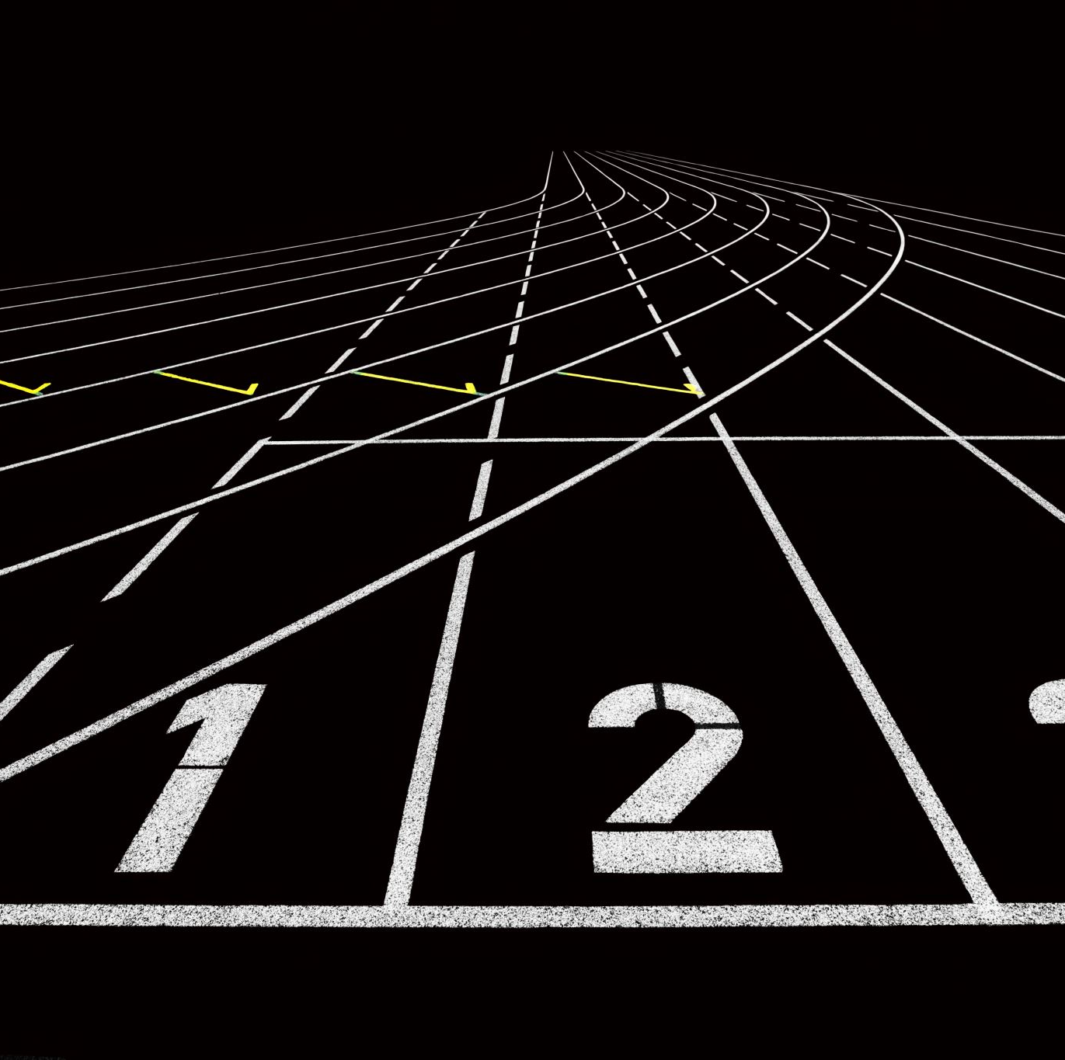
Plantastic sprint 2 review
Tevin, Lisa, Nadia, Marco and Dylan
Notes:
UPDATED

Slide 2
Contents
Planning former sprints
What is completed?
Upcoming sprint
Notes:
UPDATED

Slide 3
Planning former sprint
Complete relevant research
Create network connection diagram
Protocol creation
Framework of UI
Component testing
Notes:
UPDATED

Slide 4
What is completed?
UI Wireframe
Code for DHT11/21
Creating Protocol
Network connection diagram
Code for Accelerometer
Code for Spindle motor
Code for Touch Display
Code for motors
Reseach Documents
Notes:
UPDATED

Slide 5
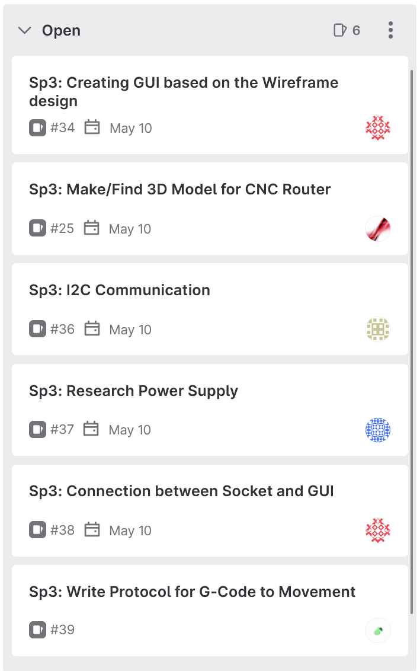
Upcoming sprint
Notes:
UPDATED

Slide 6

Questions?
Notes:
UPDATED

